Slide 2
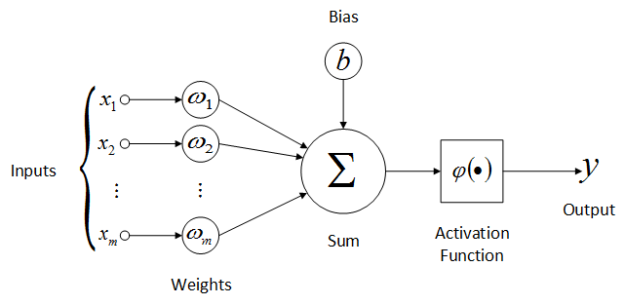
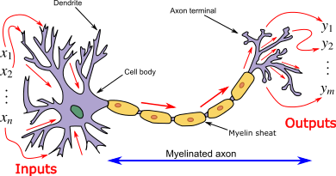
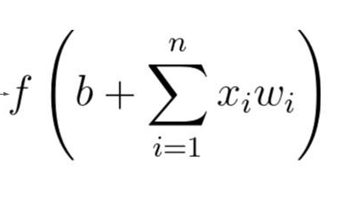
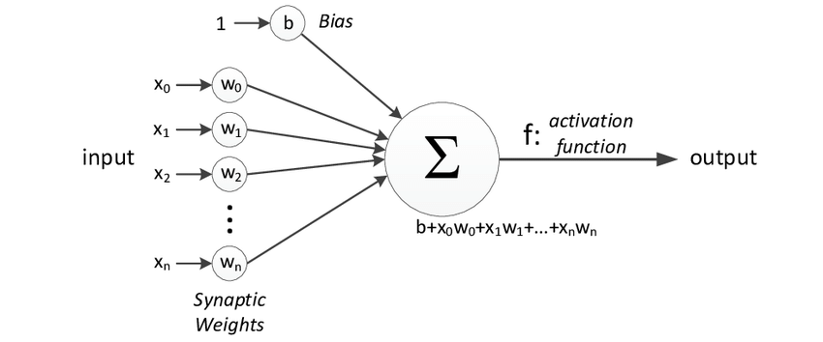
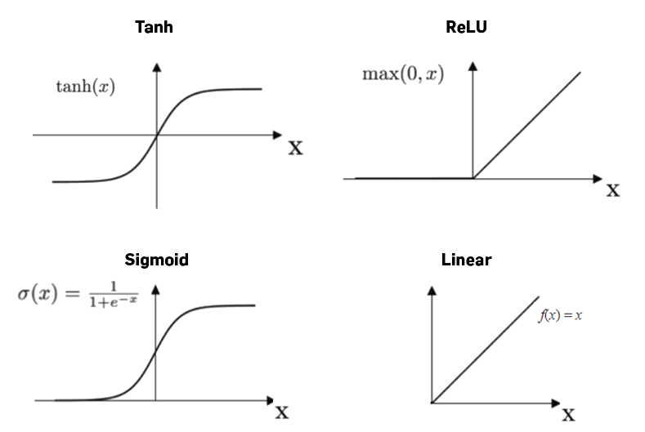
Neuron
Actual neuron
Mathematical model of neuron

Slide 3
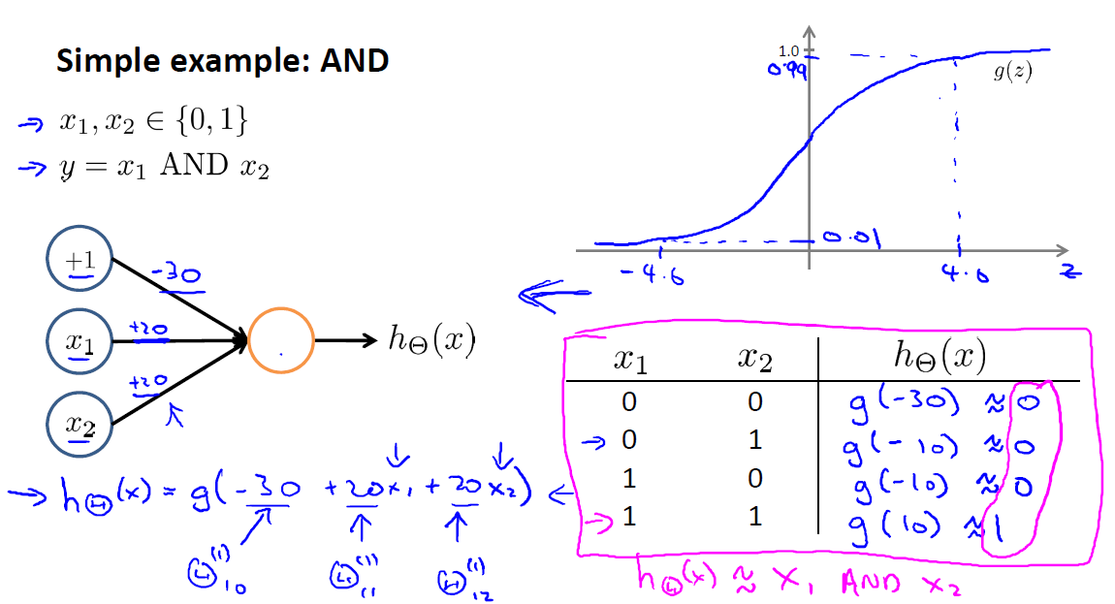
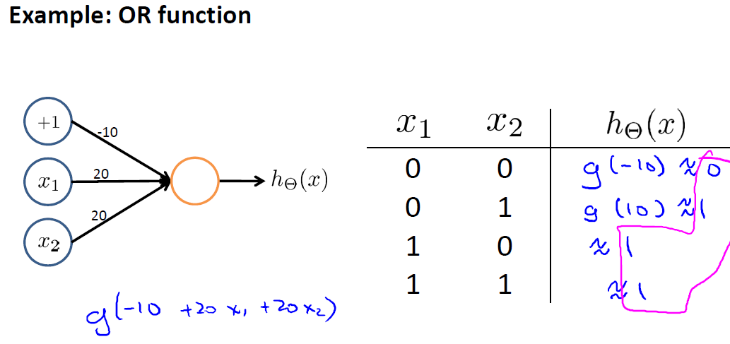
Neuron (Inference)

Slide 4
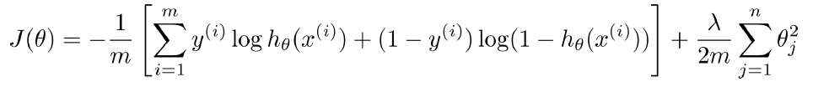
Neuron (Training)
Neuron
1
Dataset
Y= x1*x2+x3
w0
x1
w1
 | x1 | x2 | x3 | y
1 | 1 | 1 | 1 | 2
2 | 1 | 2 | 2 | 4
3 | 3 | 1 | 0 | 3
… | … | … | … | …
w2
h(x)
x2
w3
x3
δ=y-h(x)
Apply input to the neuron and calculate h(x) as output (Feedforward)
Calculate δ=y-h(x)
Multiply δ and input transpose δ*x(3,1) = Δ(3,1) (back propagation)
Update weight of affecting inputs
Cost function

Slide 5
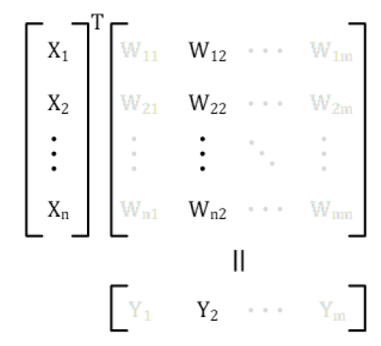
Neural network layer (inference)
N1
x1
w11
w12
w13
w1m
N2
w21
x2
w22
w23
w2m
w31
N3
w32
x3
w23
w2m
wn1
wn2
wn3
wnm
xn
Nm
Matrix representation
Neural Network Model

Slide 6
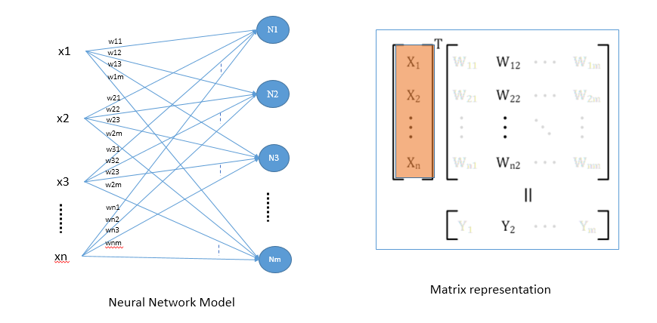
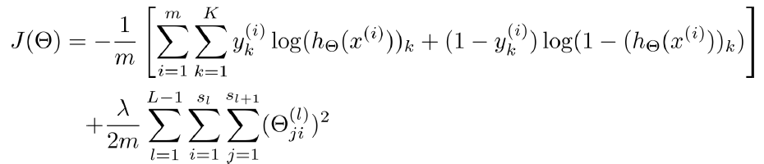
Neural network layer (training )
Apply input to the neural layer and calculate h(x) as output for all neuron h(m, 1)
Calculate δ(m,1)=y(m,1)-h(x)(m,1)
Multiply δ and input transpose δ(m,1)*x(1,n) = Δ(m,n)
Update weight of affecting inputs

Slide 7
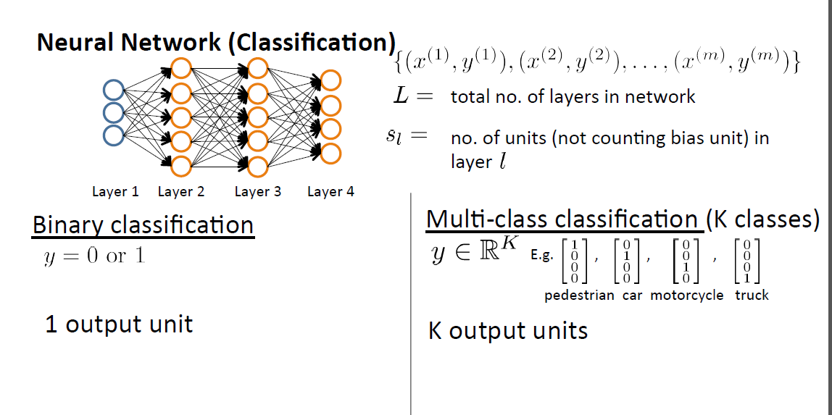
Neural networks

Slide 8
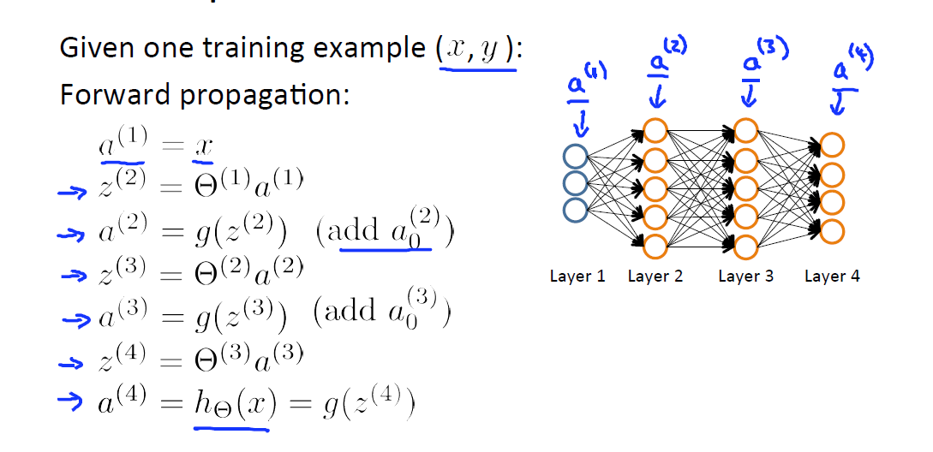
Neural networks(Inference)

Slide 9
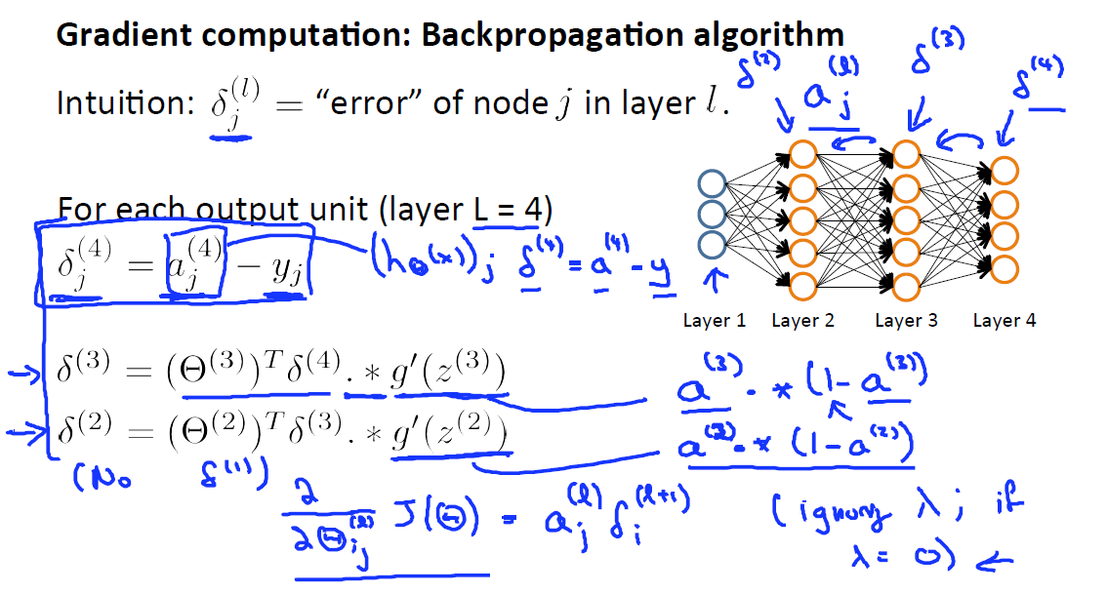
Neural networks(Training)

Slide 10
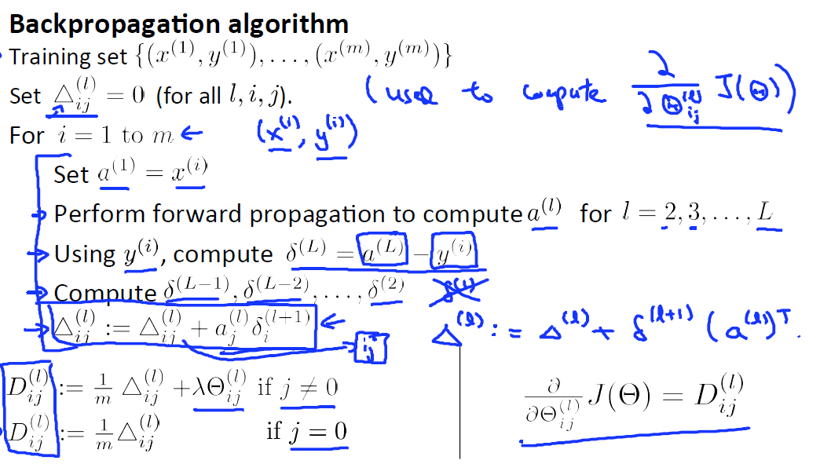
Neural networks(Training)

